Slide 1
Keepin it Real: Contextualism, Psychological Science, and the Question of Ontology
James D. Herbert
Drexel University
ACBS, Minneapolis
June 19, 2014

Slide 2
Why Philosophy?
Orienting effect on work
Distinguishing empirical questions from foundational assumptions
Clarity ➔ more informed choices

Slide 3
Mainstream Psychology
Mechanistic, convergent epistemological realism (Laudan, 1981).
Universe as a collection of events, with an independent existence regardless of human activity, organized a priori with respect to one another
Goal of science is mapping this reality via modeling; “carving nature at its joints”
Truth = correspondence between map & the world, measured by (convergent) approximations

Slide 4
Problems
Scientist has no privileged observational perch
Sensory limitations
All data theory-laden
Historical examples (e.g., Bohr’s atom)
Confounding epistemology and ontology

Slide 5
Contextualism
Descriptive vs. functional (Gifford &Hayes, 1999)
Descriptive:
Deeply personal knowledge (history, hermeneutics, field theory, etc.)
Poor basis for science; no objective guidelines for judging between narratives (beyond internal coherence)
The Renaissance
Mechanistic realism adopted as alternative

Slide 6
Functional Contextualism
Preserves contextualistic sensitivities (e.g., holistic interactions with environment, pragmatic epistemology, avoiding reification of concepts )
Key defining feature: prediction and influence as dual, foundational goals
Development of general principles (i.e., that apply to colleagues and not just oneself) & progressive science

Slide 7
Ontology in FC
Questions about the “real” nature of the universe de-emphasized
Some reject even the idea that it is in any way meaningful to speak of a reality independent of human observation (Barnes & Roche; Wilson); “a-ontology”

Slide 8
My Thesis
But saying that can’t make definitive, context-free Truth statements ≠ saying that there is no external world

Slide 9
My Thesis
The fact that (in a given context & with respect to a given goal) one analysis consistently works better than another REQUIRES that there be something that selects among competing analyses, and that is something has a “texture”
This is not a gratuitous statement, but a logical necessity
Otherwise, we end up with “anything goes” relativistic, postmodernist constructivism (e.g., the more absurd versions of Afrocentrism, radical feminist theory, or psychoanalysis; quackery)

Slide 10
My Thesis
Doing science requires the assumption of a “substratum” independent of our analyses, which has some sort of “texture” to which our analyses are oriented (“textured substratum”)
All scientists (including those using FC) recognize that some analyses work better than others in a given context (and history bears out this progressivity)
Without this assumption replication is meaningless
So again, some independent source must “select” among competing analyses

Slide 11
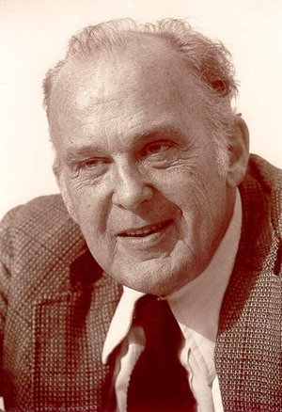
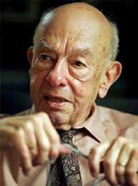
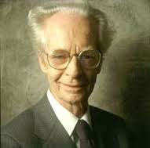
Per O’Donohue (2013), philosophers as diverse as
Campbell (1987)
Quine (1974)
Skinner (1979)
share an evolutionary perspective to epistemology requiring such an independent substratum.

Slide 12
But doesn’t this lead inevitably to elemental realism?
Don’t need to abandon contextualistic sensibilities
“texture” ≠ pre-divided parts
No assumption that analyses in different contexts must necessarily converge
Scientist remains embedded in the analytic stream
Tentativeness of all analyses emphasized

Slide 13
“A-ontology” is inconsistent with pragmatism
Failure to acknowledge a “textured independent substratum” unnecessarily alienates fellow psychological scientists who might otherwise find value in contextualistic sensitivities.
Extreme a-ontology has led to ridicule, derision, and at times even wholesale rejection of the CBS program (e.g., Tonneau, 2005).
Obscures overlap with very similar positions (e.g. “critical realism”).
Notes:
“A particularly detailed and sophisticated statement of the sort of realism
I adopt here (although focused specifically on the physical sciences) was
presented by the physicist and historian of science Evelyn Fox Keller
(1992), with the assumption that this viewpoint is so widely shared that
it needs no explicit defense. She stated,
I begin with a few philosophical platitudes about the nature of scientific
knowledge upon which I think we can agree, but which, in any case, will
serve to defi ne my own point of departure. First,
• Scientific theories neither mirror nor correspond to reality.
• Like all theories, they are models, in Geertz’s (1973) terms, both models
of and models for, but especially, they are models for; scientific theories
represent in order to intervene, if only in search of confirmation. And
the world in which they aim to intervene is, first and foremost, the world
of material (that is, physical) reality. For this reason, I prefer to call them
tools. From the first experiment to the latest technology, they facilitate
our actions in and on that world, enabling us not to mirror, but to bump
against, to perturb, to transform that material reality. In this sense scientific
theories are tools for changing the world.
• Such theories, or stories, are invented, crafted, or constructed by human
subjects, interacting both with other human subjects and with nonhuman
subjects/objects.
• But even granted that they are constructed, and even abandoning the
hope for a one-to-one correspondence with the real, the effectiveness of
these tools in changing the world has something to do with the relation
between theory and reality. To the extent that scientific theories do in
fact “work”—that is, lead to action on things and people that, in extreme
cases (for example, nuclear weaponry), appear to be independent of any
belief system—they must be said to possess a kind of “adequacy” in relation
to a world that is not itself constituted symbolically—a world we
might designate as “residual reality.”
• I take this world of “residual reality” to be vastly larger than any possible
representation we might construct. Accordingly, different perspectives,
different languages will lead to theories that not only attach to the real in
different ways (that is, carve the world at different joints), but they will
attach to different parts of the real—and perhaps even differently to the
same parts. (pp. 73–74)”

Slide 14
So who cares anyway? (besides philosophy geeks)
FC’s position on ontology sensitizes scientist to the tentative, provisional, contextual nature of knowledge
This becomes especially important when using realist language (including causal statements)
But, rejecting the mere existence of anything beyond analyses hinders wider adoption
Example: the case of PTSD
Notes:
PTSD
History
Enshrinement in DSM-III
Reification
Effects on research
Resnick’s pygmy study
Foa’s historical analysis
Over-emphasis on criterion A
Many others
How would studying post-traumatic reactions with an “a-ontological” sensibility look?
Don’t these questions have an ontological element?
Do vaccines cause autism?
What is the origin of repressed memories of childhood sexual abuse?
Do cognitive restructuring interventions add to the effects of exposure for phobias?
How does the confirmation bias affect psychodiagnostic judgments?
Did dinosaurs and humans co-exist?
Is there a Starbucks in the hotel?

Slide 15
We have to remember that what we observe is not nature herself, but nature exposed to our method of questioning.
Werner Heisenberg

